Slide 1

CUSTOMER FEEDBACK ANALYSIS
Nithin Narayanan P B CH.EN.U4CCE21037

Slide 2
Motivation
In today’s world, the understanding and exploitation of human emotion are challenges in Marketing; it allows enterprise to understand the opinion being expressed on products. Currently the majority of enterprise use conventional marketing methods based on advertising, price, sale points, and satisfaction surveys etc.
Those methods were exceeded relative to the cost, time and data reliability and lacks then means of distinguishing between a rational and an emotional answer.
Nowadays, Leading marketers are using data to deliver greater value and relevance to their customer.
2

Slide 3
Objective
The aim of the study is to help the enterprise understand the opinion being expressed on the products. In this project we propose to analyse the customer emotion on a single product (chocolate) and classify it into 3 categories such as satisfied,unsatisfied and neutral,which proves to be a determining factor of the product sales.
3

Slide 4
Literature Survey
Reference Number | Problem Identification | Methodology Used | Advantage, Disadvantage
1. | AUTOMATIC DEPRESSION DETECTION VIA FACIAL EXPRESSIONS USING MULTIPLE INSTANCE LEARNING | Coarse Grain Detection | This was accomplished by using LSTM.
2. | Automatic emotion recognition for groups | Viola Jones and different data sets | Data sets
3. | Automatic emotion recognition for groups | Viola Jones and different data sets | Data sets
4. | Emotion Detection through Speech and Facial Expressions | SVM based object detection and classification | More Accuracy
4

Slide 5
Literature Survey
Reference Number | Problem Identification | Methodology Used | Advantage, Disadvantage
5. | Facial Expression Recognition in Video with Multiple Feature Fusion | HOG (Histogram Oriented Gradient) | Feature detection
4

Slide 6
Literature Survey
Reference Number | Problem Identification | Methodology Used | Advantage, Disadvantage
6. | Difficulty in accurately recognizing emotions from facial images | Facial expression recognition using a convolutional neural network (CNN). CNN architecture with recursive method | More accurate than traditional feature-based methods
7. | Facial expression recognition is a challenging task due to the complexity of human facial expressions and the variability in illumination, pose, and other factors. | Enhances the features of an image and allows the CNN to automatically extract the image features to make the features more obvious | More complex than the original CNN architecture
4

Slide 7
Problem Identifications
High Emotion Detection Variability: Numerous research efforts have explored emotion detection, and they often encounter significant variability in results.
Algorithm and Dataset Variations: Researchers have experimented with various algorithms and datasets, which have led to differing outcomes in emotion detection accuracy.
Consistency Challenges: Achieving consistent results across different studies has been a challenge, highlighting the need for standardization in the field.
Importance of Accuracy: Accurate emotion detection is crucial for applications like customer satisfaction analysis and human-computer interaction.
Reducing Variability: Researchers aim to minimize the variability in emotion detection by exploring novel techniques and refining existing ones.
Improving Reliability: Enhancing the reliability of emotion detection models is essential for real-world applications and decision-making.
6

Slide 8
Proposed Work
Face Detection using Viola jones algorithm
Followed by Emotion Recognition using
Convolutional neural network. The algorithm consists of 4 stages:
Convolution Layer
Rectified Linear Unit
Pooling layers
fully connected layer
Feedback classification to Each class followed by graphical result as per User requirement.
7

Slide 9
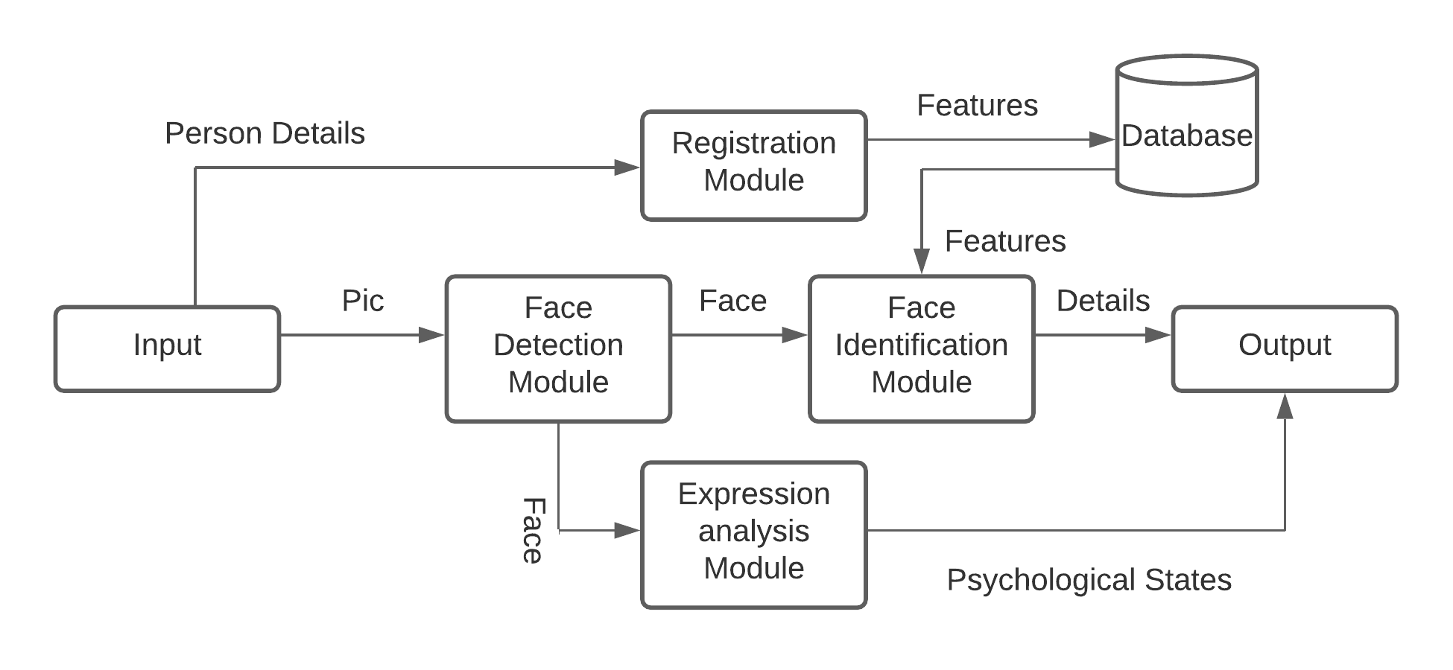
Methodology
8

Slide 10
Tools/Platform
Pycharm : a code editor used to implement libraries and packages with python codes.
Jupyter notebook : used as an alternative of Pycharm for easy use.
Laptop front cam : used to test code in real time environment
Libraries :
Tensorflow : TensorFlow offers APIs that facilitates Machine Learning. TensorFlow also has a faster compilation time than other Deep Learning libraries such as Keras and Touch
Dlib : dlib is used to estimate the location of 68 coordinates (x, y) that map the facial points on a person’s face
Opencv : This is a cross-platform library using which we can develop real-time computer vision applications. It mainly focuses on image processing, video capture and analysis including features like face detection and object detection
9

Slide 11
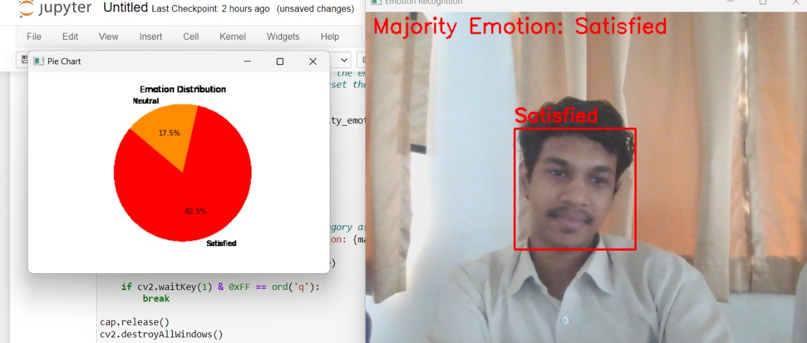
Results
10

Slide 12
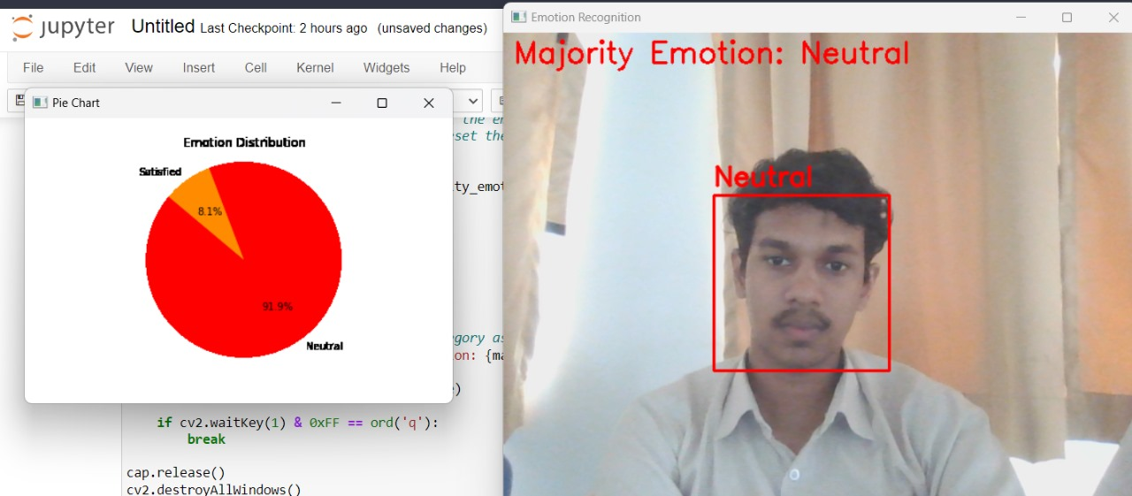
Results
10

Slide 13
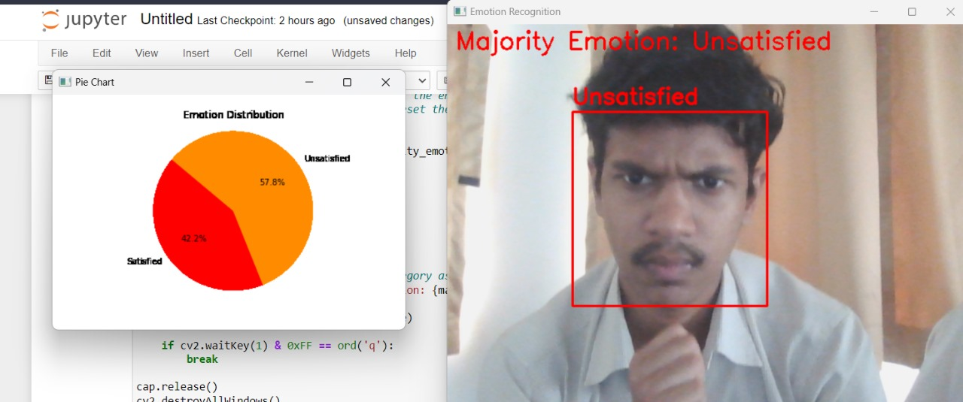
Results
10

Slide 14
Conclusions
Our project aims to address the crucial challenge of understanding and analyzing customer satisfaction in the context of marketing. We have identified the problem of conventional marketing methods being limited in their ability to capture the emotional responses of customers to products and services. To overcome this limitation, we have developed a system that combines facial emotion recognition with classification techniques to determine customer satisfaction levels.
10

Slide 15
References
Yanfei Wang, Jie Ma, Bibo Hao, Pengwei Hu, Xiaoqian Wang, Jing Mei, Shaochun Li, AUTOMATIC DEPRESSION DETECTION VIA FACIAL EXPRESSIONS USING MULTIPLE INSTANCE LEARNING
Emmeke A. Veltmeijer, Charlotte Gerritsen, and Koen V. Hindriks, Automatic emotion recognition for groups
Takeo Kanade, Jeffrey F. Cohn, Yingli Tian. Automatic emotion recognition for groups
Junkai Chen, Zenghai Chen, Zheru Chi, Hong Fu, Facial Expression Recognition in Video with Multiple Feature Fusion
12

